Slide 1

Survival Analysis in the Women's Interagency HIV Study (WIHS) Insights on HAART Initiation and AIDS Outcomes
Kien Le, Sandani Kumanayake, and Akpene Tetteh

Slide 2
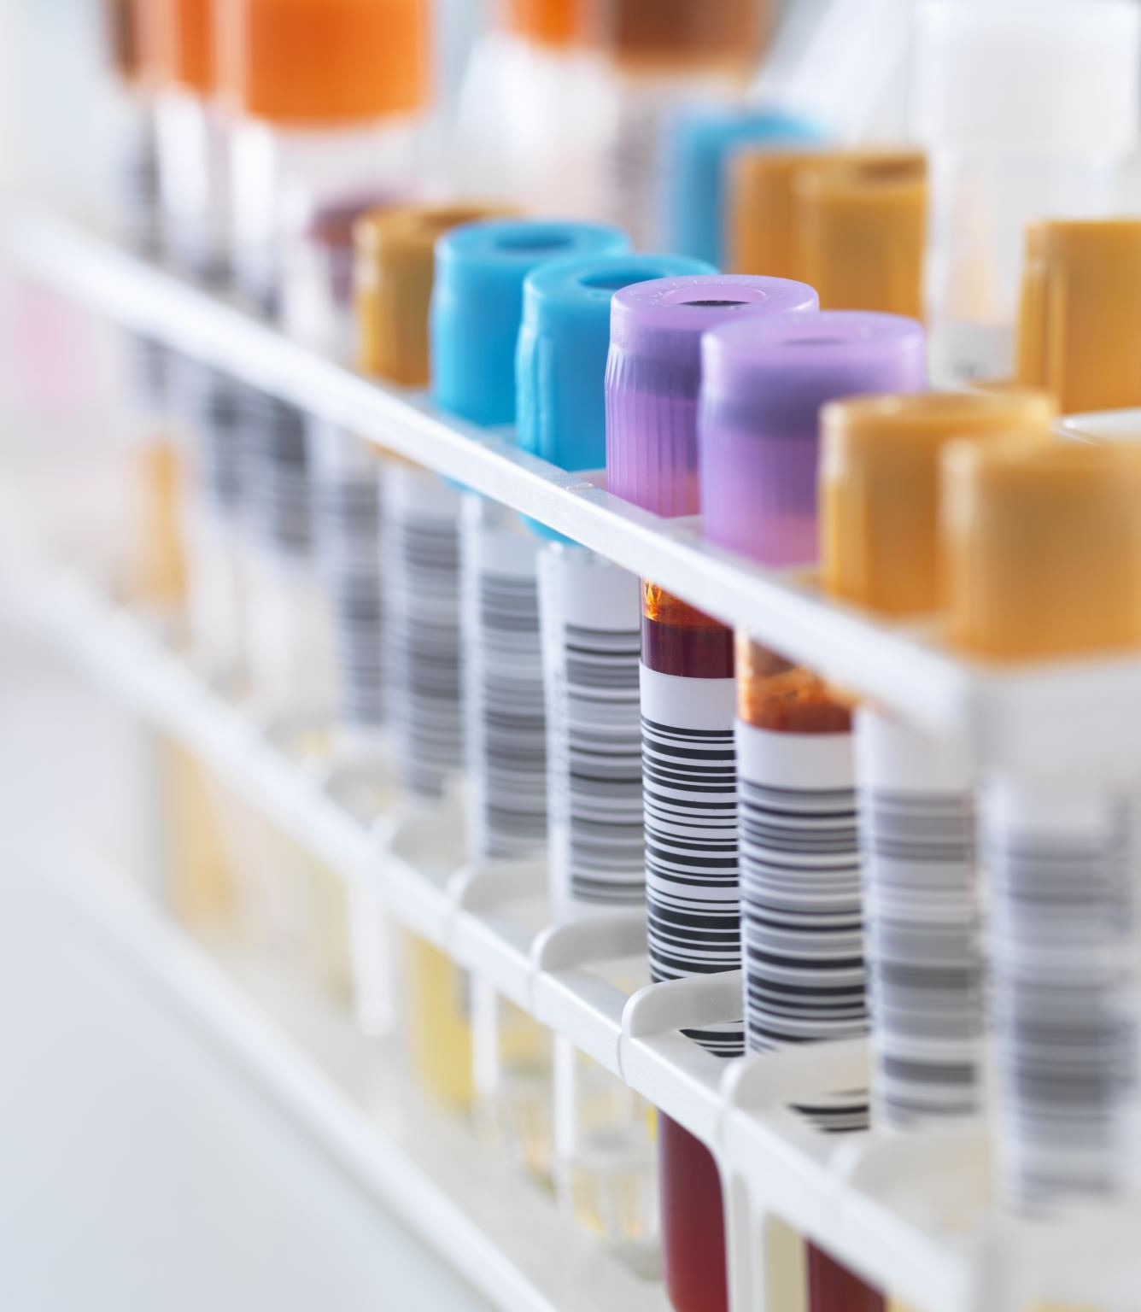
Background
Definition: Human Immunodeficiency Virus (HIV) is a virus that attacks the immune system. If not treated, it can lead to Acquired Immunodeficiency Syndrome (AIDS).
Global Statistics: Approximately 39 million people worldwide living with HIV/AIDS as of 2022.
Common transmission routes: Sexual contact, blood transfusions, shared needles, from mother to child during childbirth or breastfeeding.
Biological vulnerability: Women are biologically more susceptible to HIV infection.
Reproductive health complications: HIV-positive women face higher risks of complications in pregnancy and childbirth, increased risk of cervical cancer, and challenges in family planning.
References: UNAIDS (2022), WHO Guidelines

Slide 3
Research Questions
1. How does the survival probability change across time for different groups in the dataset following the initiation of HAART or an AIDS Diagnosis/Death?
2. What combination of factors best explains the time to initiation of HAART or an AIDS Diagnosis/Death?
3. What is Random Survival Forest modeling, and how can it be used with this dataset to predict HIV outcomes?

Slide 4
Study Design
Study Background
Objective: To analyze the long-term impacts of HIV treatment following the approval of the first protease inhibitor.
Study Period: December 1995 to September 2006
Event of Interest: Initiation of HAART, AIDS diagnosis, or death.
Participants
Population: 1164 women infected with HIV and free of clinical AIDS at study start.
Criteria: Participants were alive when protease inhibitors became available and had data available for follow-up.

Slide 5
WIHS Data set
Key Variables
ageatfda: Age at the time of FDA approval of saquinavir mesylate.
black: African-American status.
idu: History of Injection Drug Use at enrollment.
cd4nadir: Lowest CD4 count prior to baseline (per 100 cells/μl).
Follow-up and Censoring
Follow-up ended at treatment initiation, AIDS diagnosis, death, or in September 2006.
Censoring status indicated for participants without the event.

Slide 6
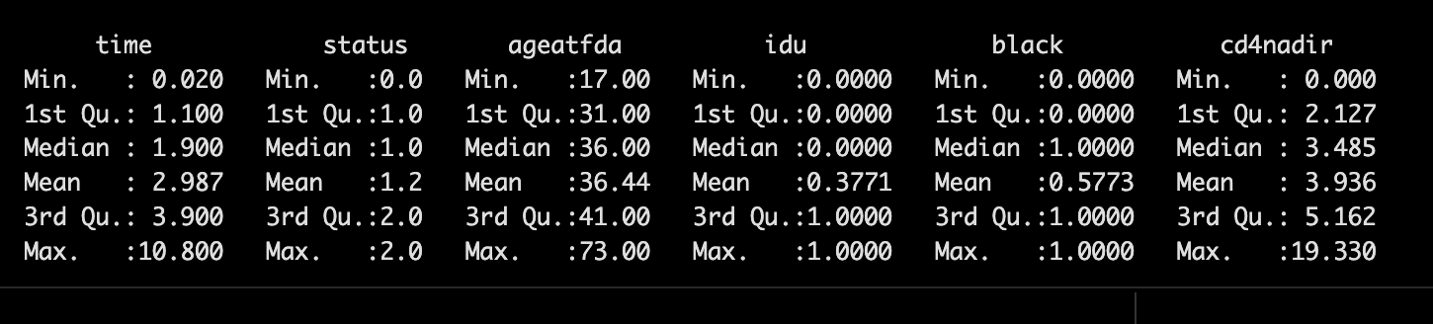
Summary Statistics

Slide 7

Exploratory Data Analysis

Slide 8
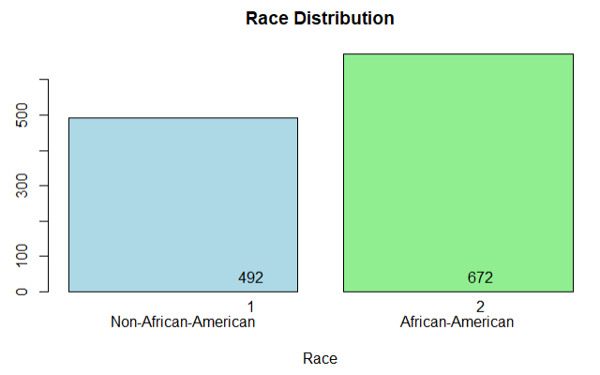
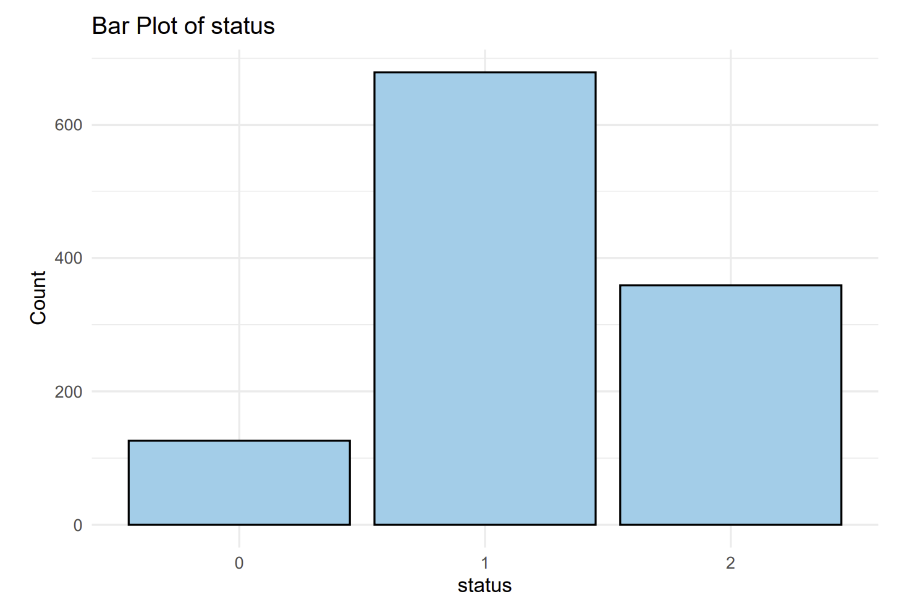
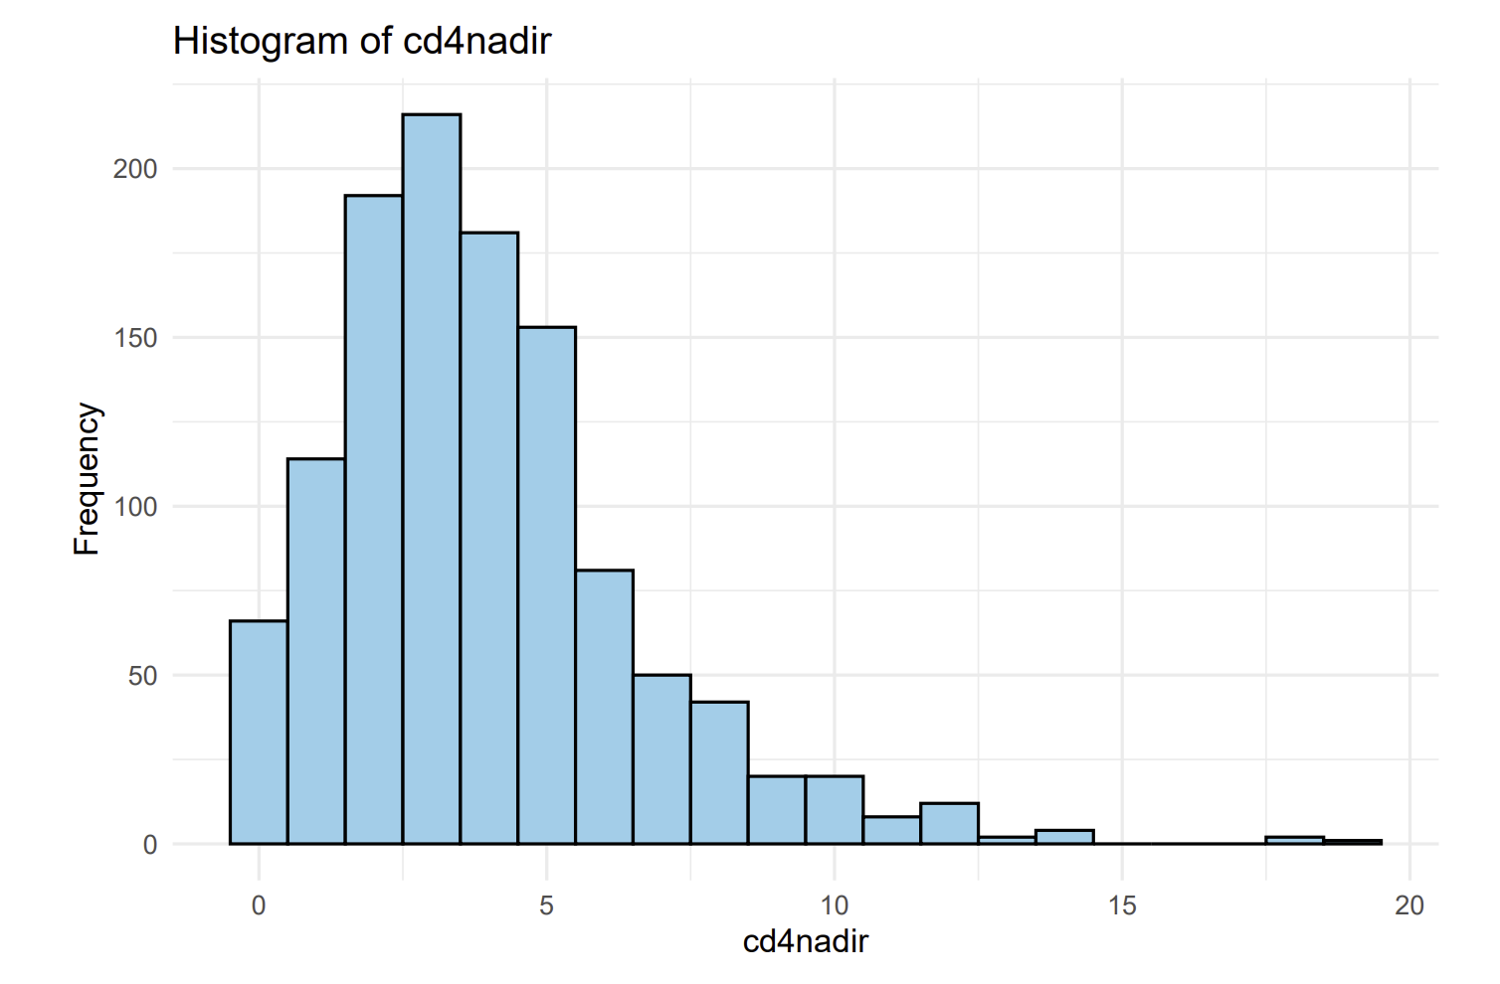
Bar plot: count by black race
Bar plot: count by ‘status’
Cd4 count distribution

Slide 9
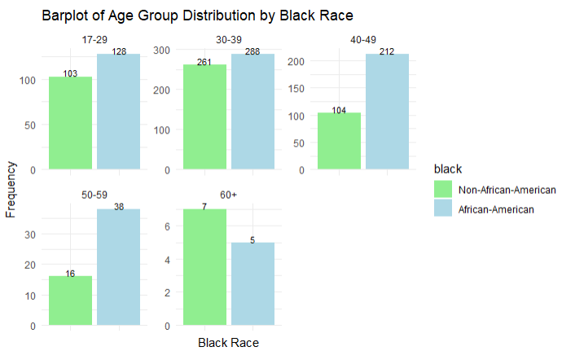
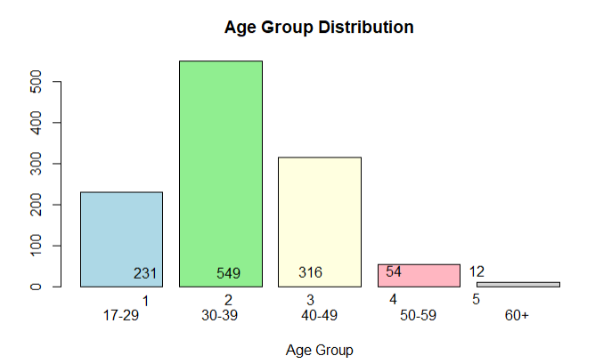
Bar plot: count by age_groups
Bar plot: count of age_groups by RACE

Slide 10
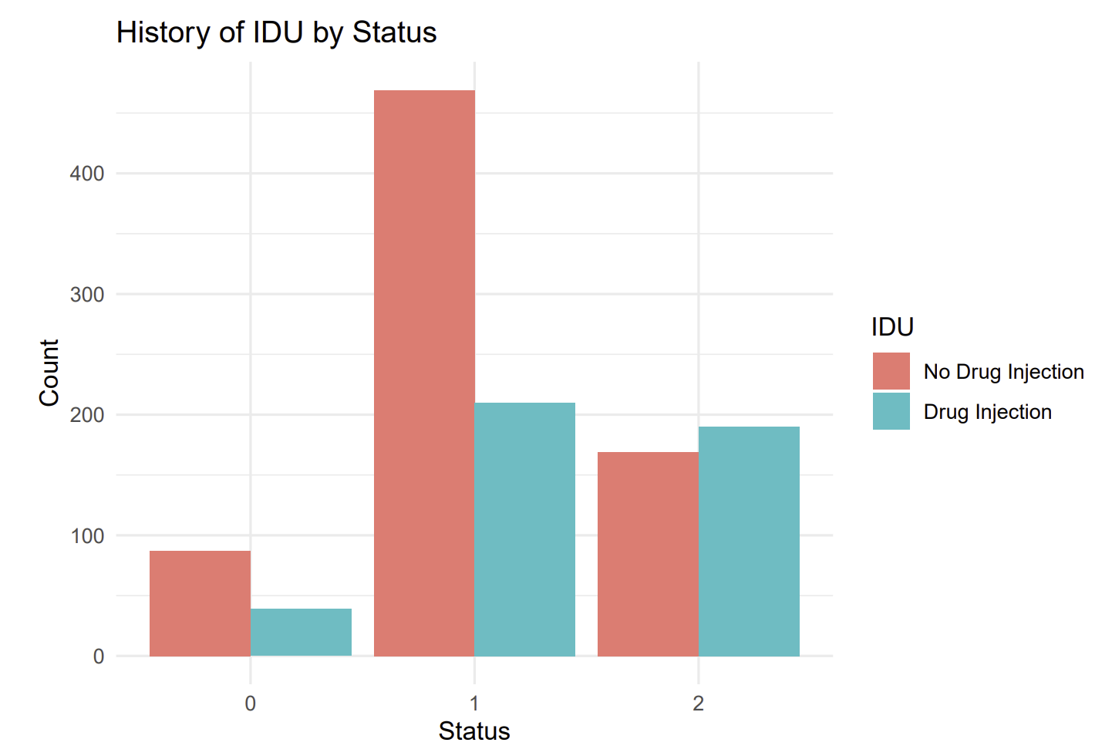
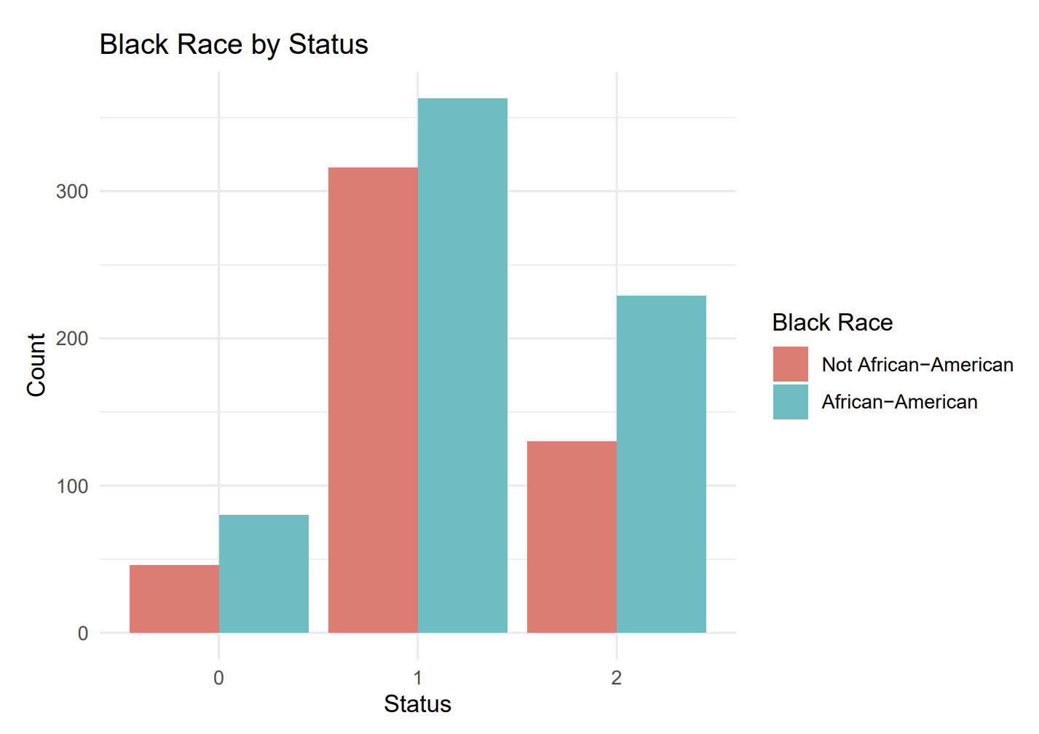
Bar plot: count by age_groups
Black Race by Status

Slide 11
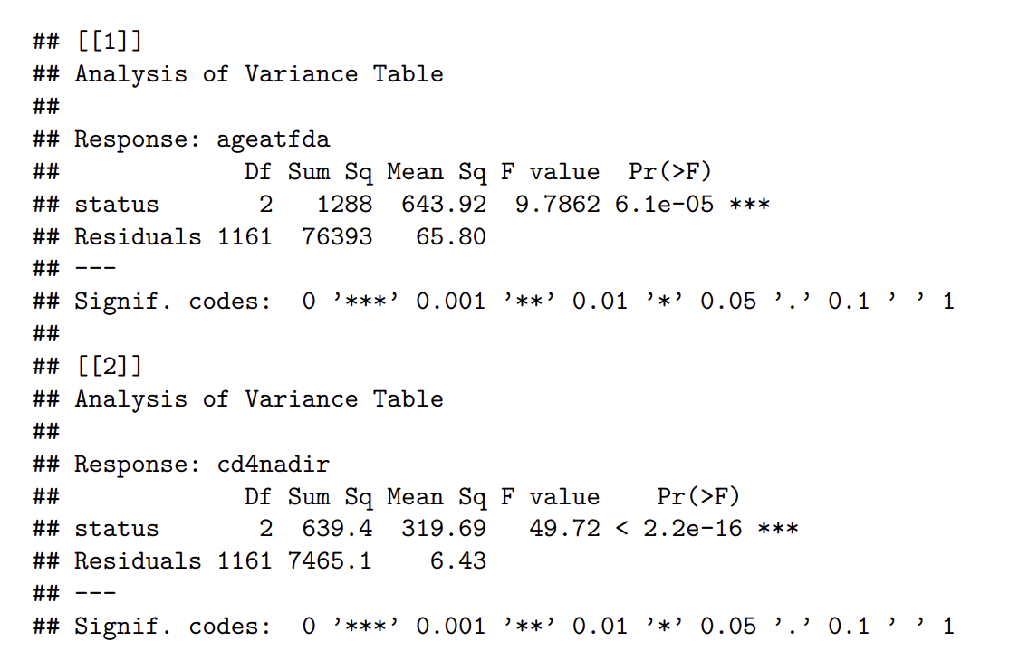
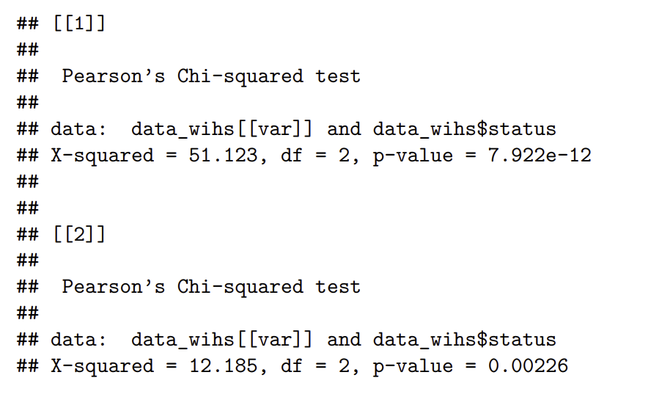
ANOVA & CHI-Squared
Continuous vs. ‘Status’
Categorical vs. ‘Status’
Significant association between the variables status and idu (history of intravenous drug use) with a p-value of 7.922e-12. This suggests that there is evidence to reject the null hypothesis of independence between these two variables. Therefore, there appears to be a statistically significant relationship between history of intravenous drug use and the status (censoring status) of the individuals in the dataset.

Slide 12

Methods

Slide 13
Overview of Survival Analysis Techniques
Kaplan-Meier Curves: a non-parametric statistic used to estimate the survival function from lifetime data.
These curves provide a simple way to visualize how survival probabilities decrease over time.
The survival function is calculated at each time point when an event occurs, taking censored data into account.
Cox Proportional Hazards Model: a semi-parametric model widely used in the analysis of survival data to explore the effect of several variables on the time a specified event takes to happen.
Proportional hazards assumption, which assumes that the effects of the predictor variables are multiplicative with respect to the hazard rate.
Allows for the adjustment of confounding variables and can provide insights into which factors might increase or decrease survival time.

Slide 14

Stratification
Stratification is used to control confounding and to ensure that comparisons between groups are fair.
Stratification by Age:
Categories Used: 17-29, 30-39, 40-49, 50-59, 60+
Stratification by Race:
Categories Used: African-American vs non-African-American
Stratification by IDU:
Categories Used: 0 for no history of IDU, 1 for history of IDU

Slide 15

Log Rank Test
•Two independent groups: HAART initiation (group 0,1) & AIDS diagnosis or death (group 0,2)
•Null Hypothesis (H0): The survival curves of all groups are the same across the study period.
•Alternative Hypothesis (H1): At least one of the groups has a different survival curve from the others.
•We define our alpha as 5%
•A p-value <0.05 indicates strong evidence against the null hypothesis, suggesting a statistically significant difference in survival experiences among the groups.
•A p-value >0.05 suggests that there is not enough evidence to reject the null hypothesis, implying that the survival curves are similar across the groups.

Slide 16
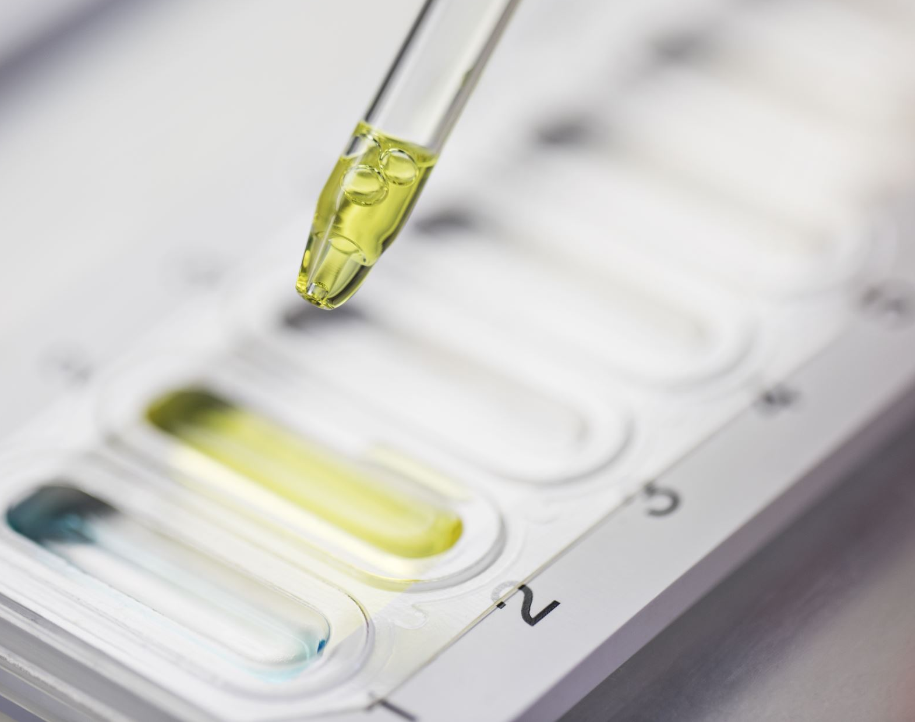
Survival Analysis

Slide 17
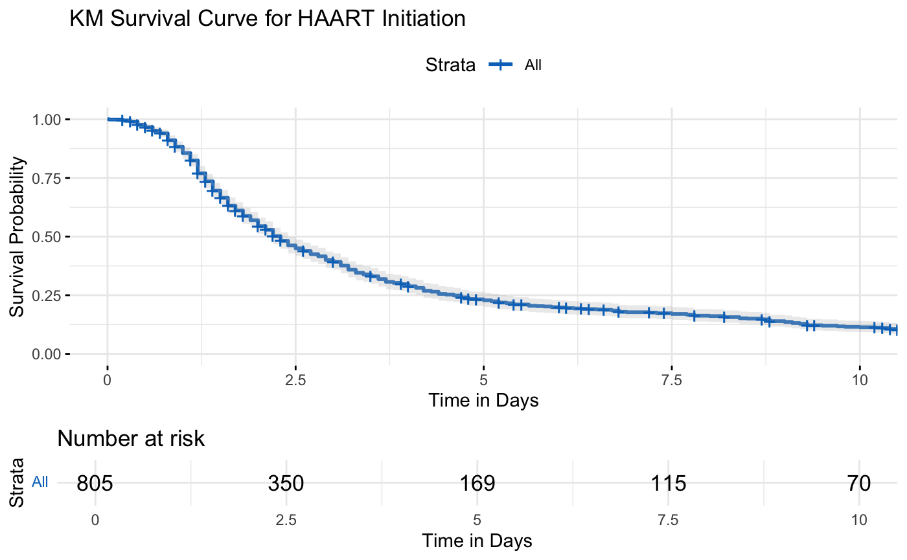
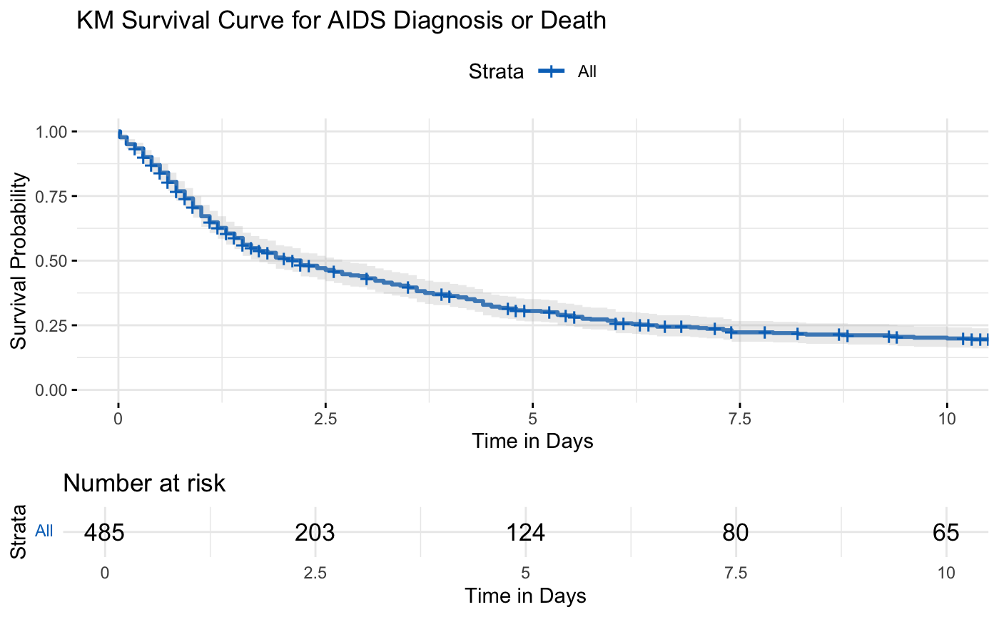
KM Curves
Assumptions: 1. Independence Between Subjects
2. Independence Within Group Comparisons: HAART initiation (group 0,1) and its effect on AIDS diagnosis or death (group 0,2)
Notes:
More women are at risk as at the time of HAART initiation compared to at the time of being diagnosed with AIDs.
Number at risk against time in days Group (0,1) Survival in 2.5 days is 37.5%; 5 to 10 days is ~13%; Group (0,2): Survival in 2.5 days is 48%; 5 to 10 days is ~25%

Slide 18
KM Curves with stratifications for HAART Initiation Event

Slide 19
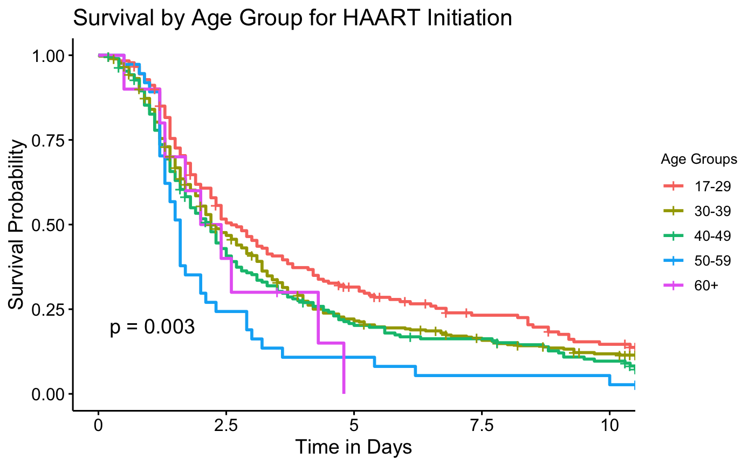
Notes:
the survival rate for initiation of Highly Active Antiretroviral Therapy (HAART) among the women with HIV decreases with increase in age.

Slide 20
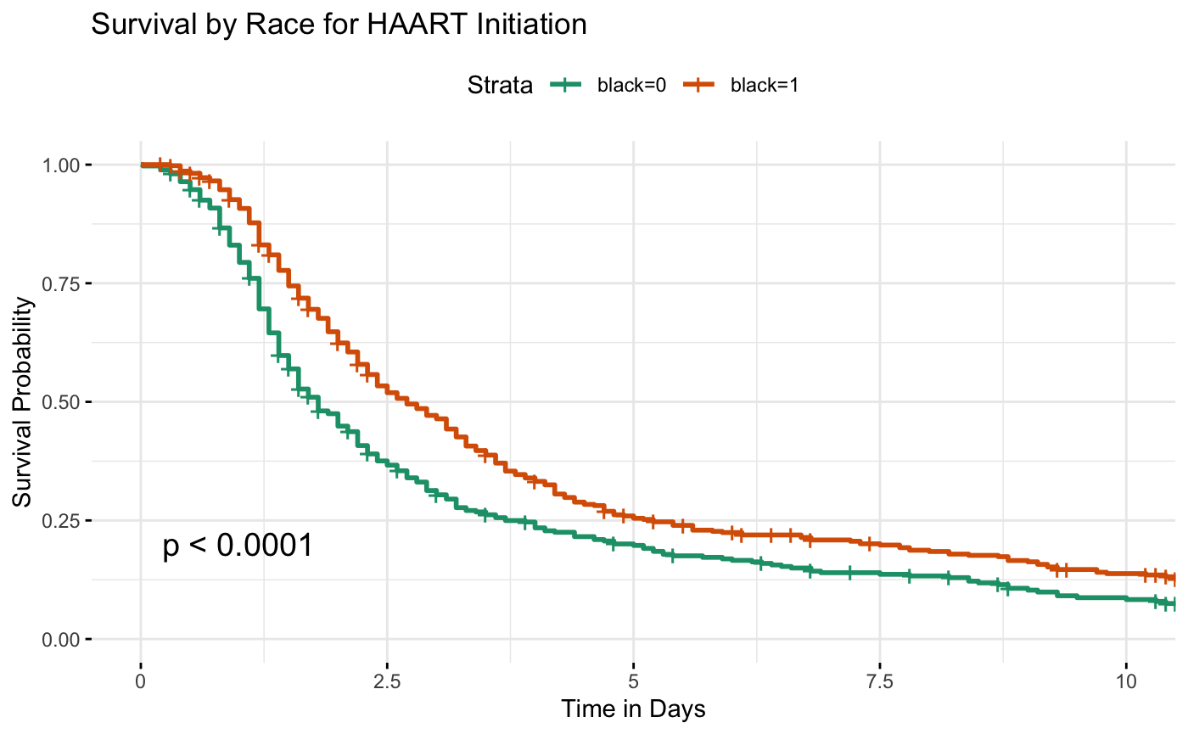
Notes:
Blacks: African-Americans have a higher probability of survival when the Highly Active Antiretroviral Therapy (HAART) is initiated compared to non-African_American

Slide 21
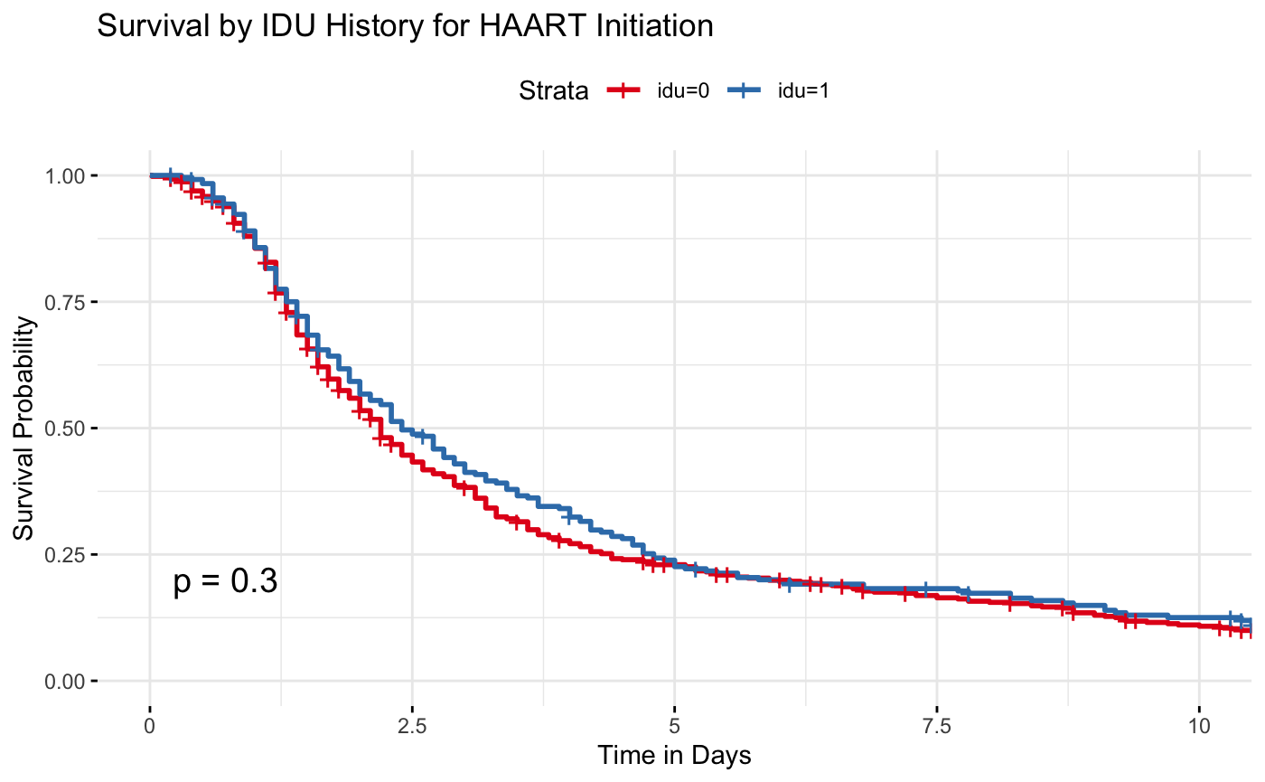
Notes:
There is no association between the history of injection drug use at enrollment and the effect of the Highly Active Antiretroviral Therapy (HAART) initiation

Slide 22
KM Curves with stratifications for AIDS Diagnosis or Death Event

Slide 23
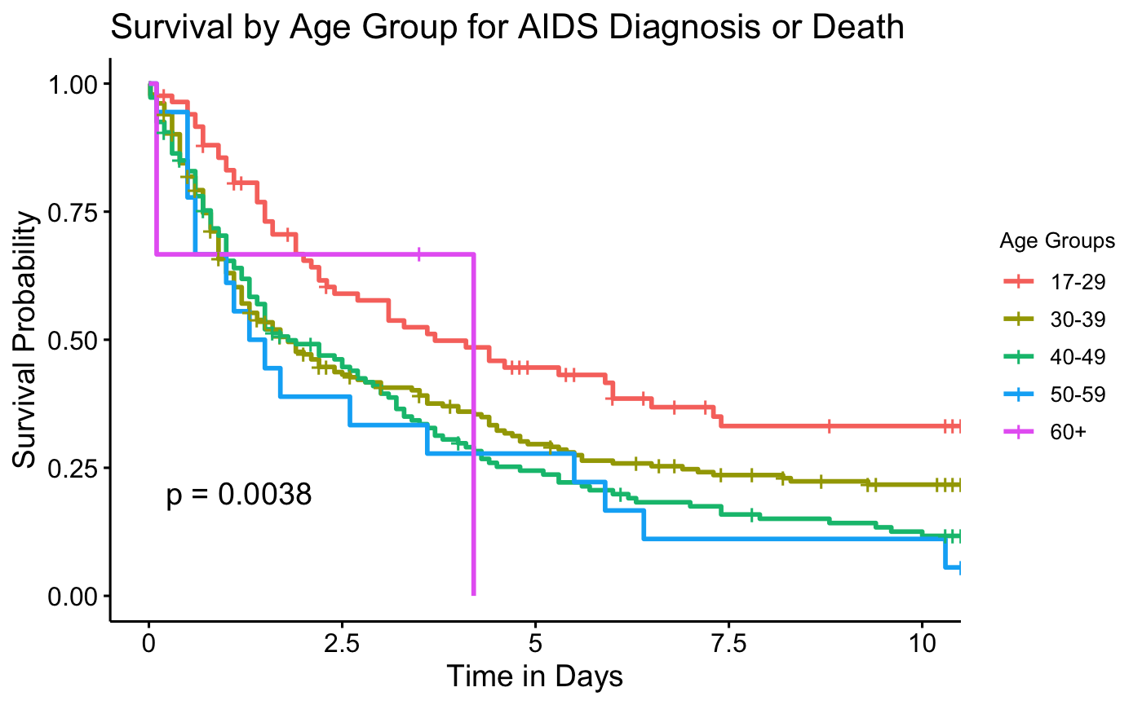
Notes:
the survival rate for the effect of the initiation of Highly Active Antiretroviral Therapy (HAART) among the women with HIV on the diagnosis of AIDs or death decreases with increase in age. Women over 60 years are more vulnerable and least to survive.

Slide 24
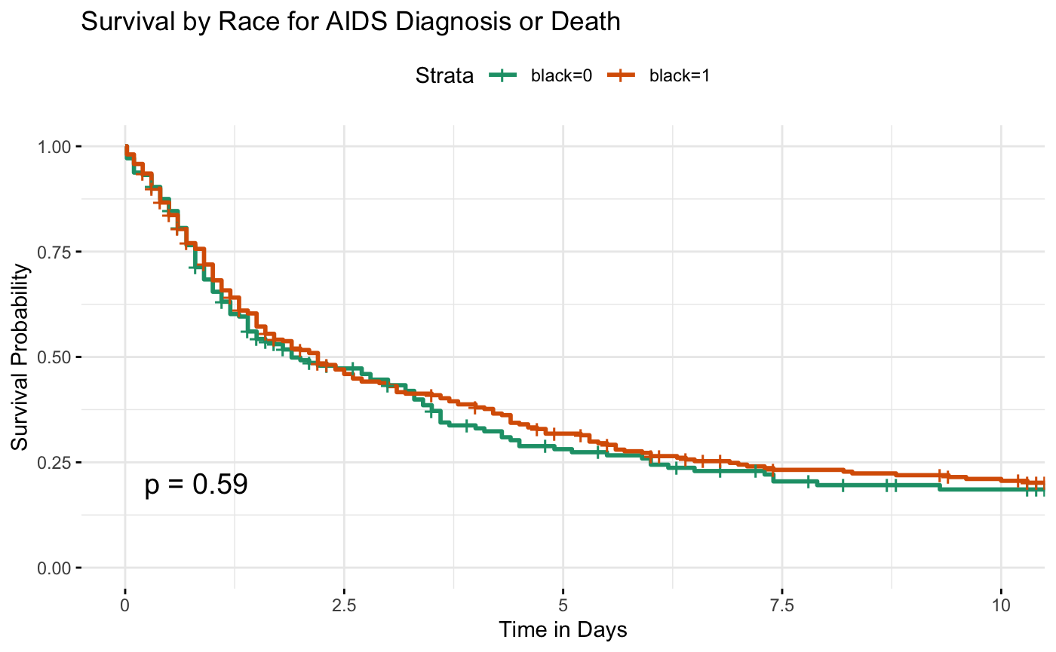
Notes:
Blacks: African-Americans have a higher probability of survival when the Highly Active Antiretroviral Therapy (HAART) is initiated compared to non-African_American. But its effect on the diagnosis or death rate from AIDs is not statistically significant, and there is no difference between blacks who are African_Amereican and the non_African_Amereican.

Slide 25
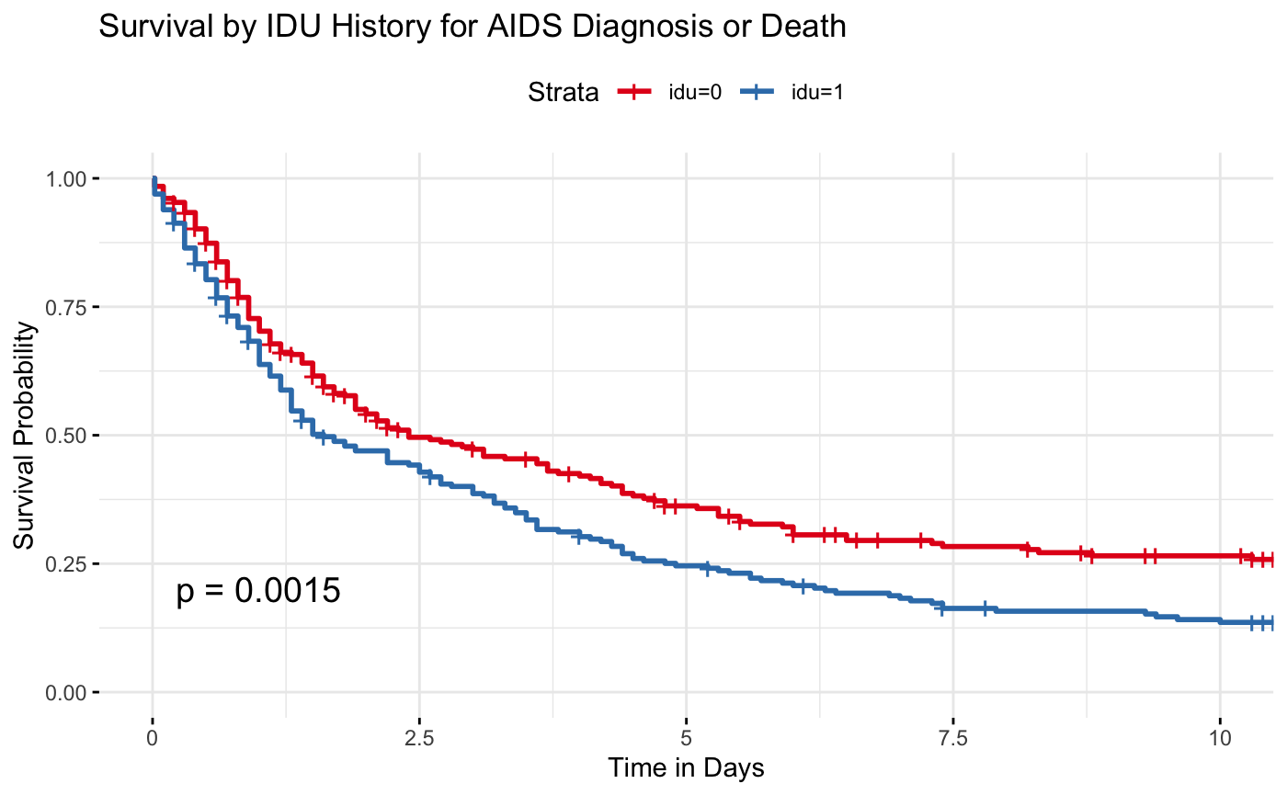
Notes:
interesting to note that whiles there was no association between the history of injection drug use at enrollment and the effect of the Highly Active Antiretroviral Therapy (HAART) initiation; there is an association of the HAART effect on the diagnosis or death with IDU history

Slide 26
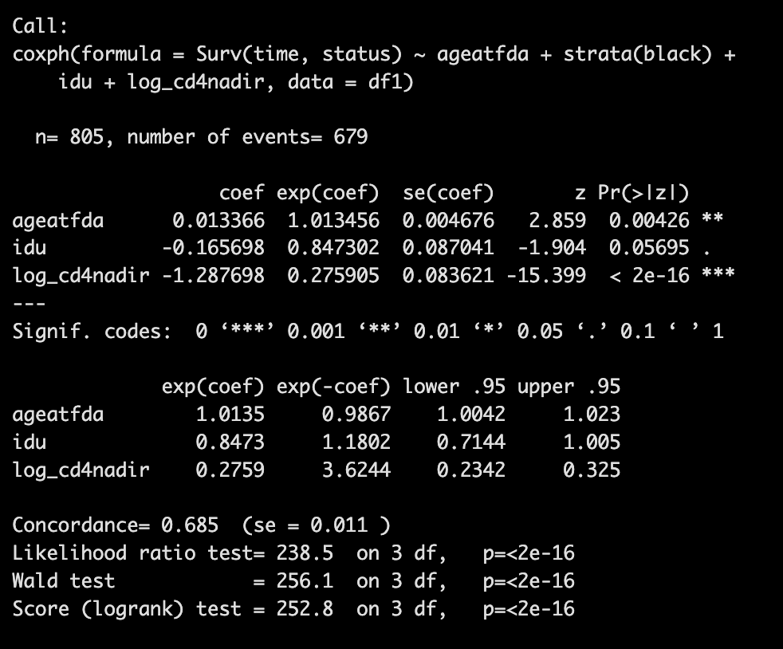
Cox ph model for HAART Initiation Event
coxph(formula = Surv(time, status) ~ ageatfda + strata(black) + idu + log_cd4nadir, data = df1)

Slide 27
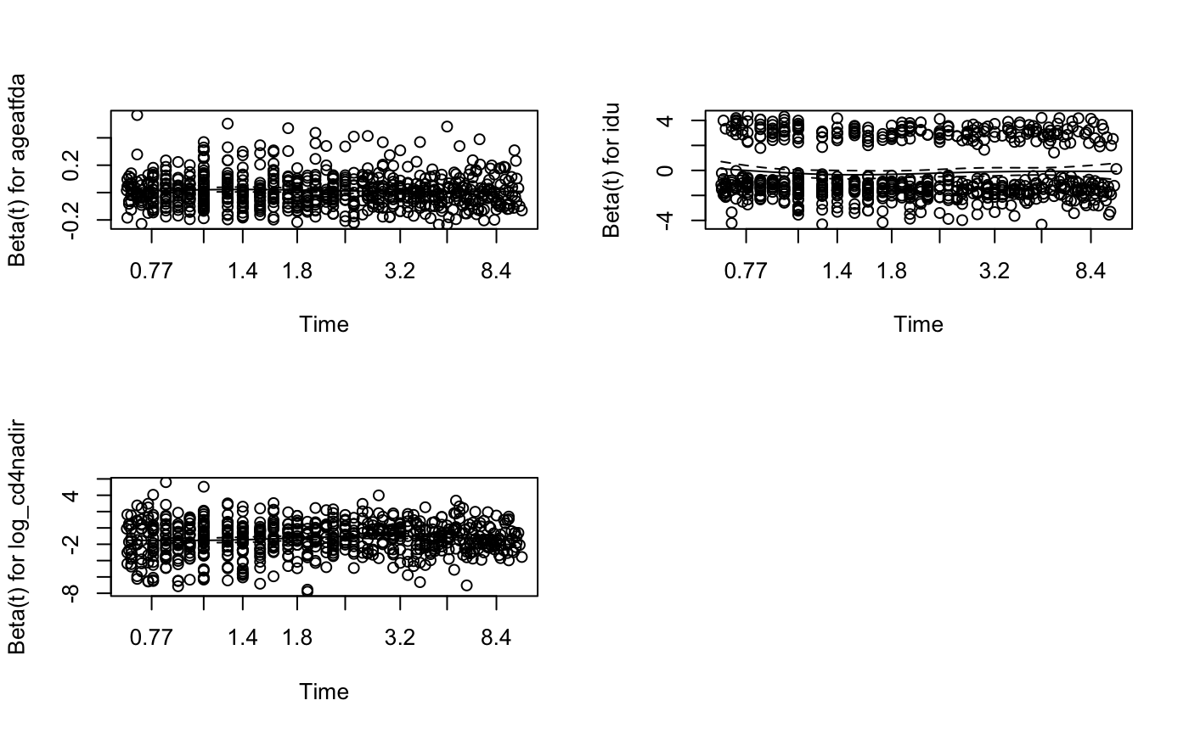
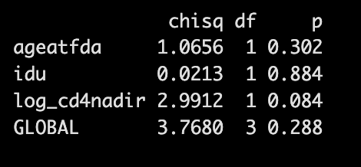
Schoenfeld Residuals Test and plots

Slide 28
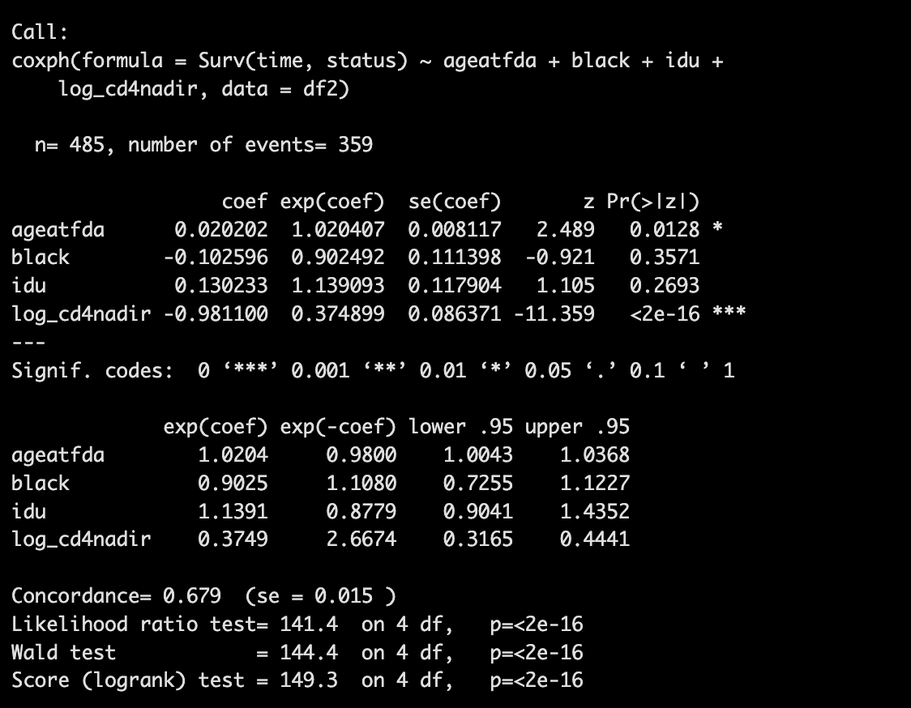
Cox ph model for AIDS Diagnosis or Death Event
coxph(Surv(time, status)
~ ageatfda + black + idu + log_cd4nadir, data = df2)

Slide 29
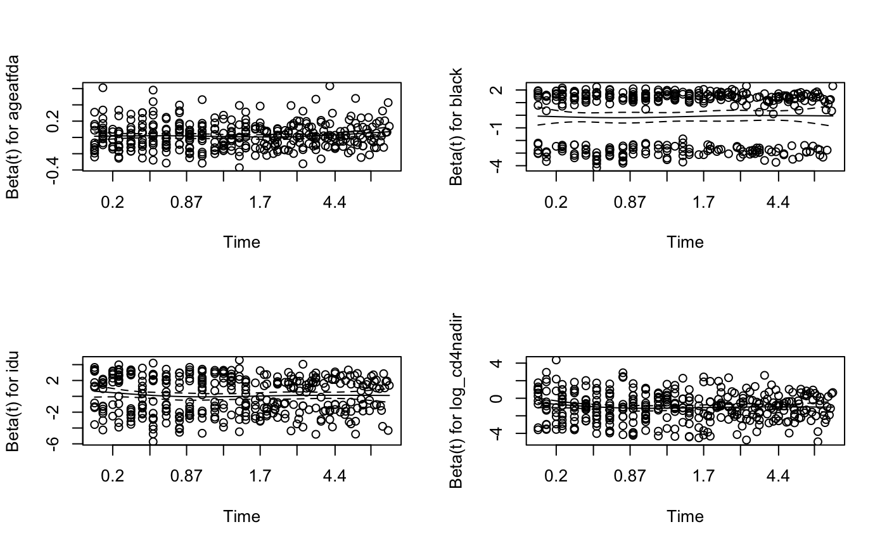
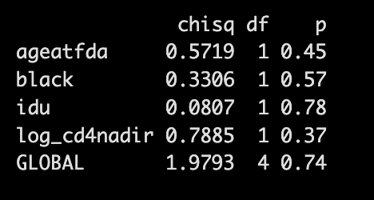
Schoenfeld Residuals Test and plots

Slide 30
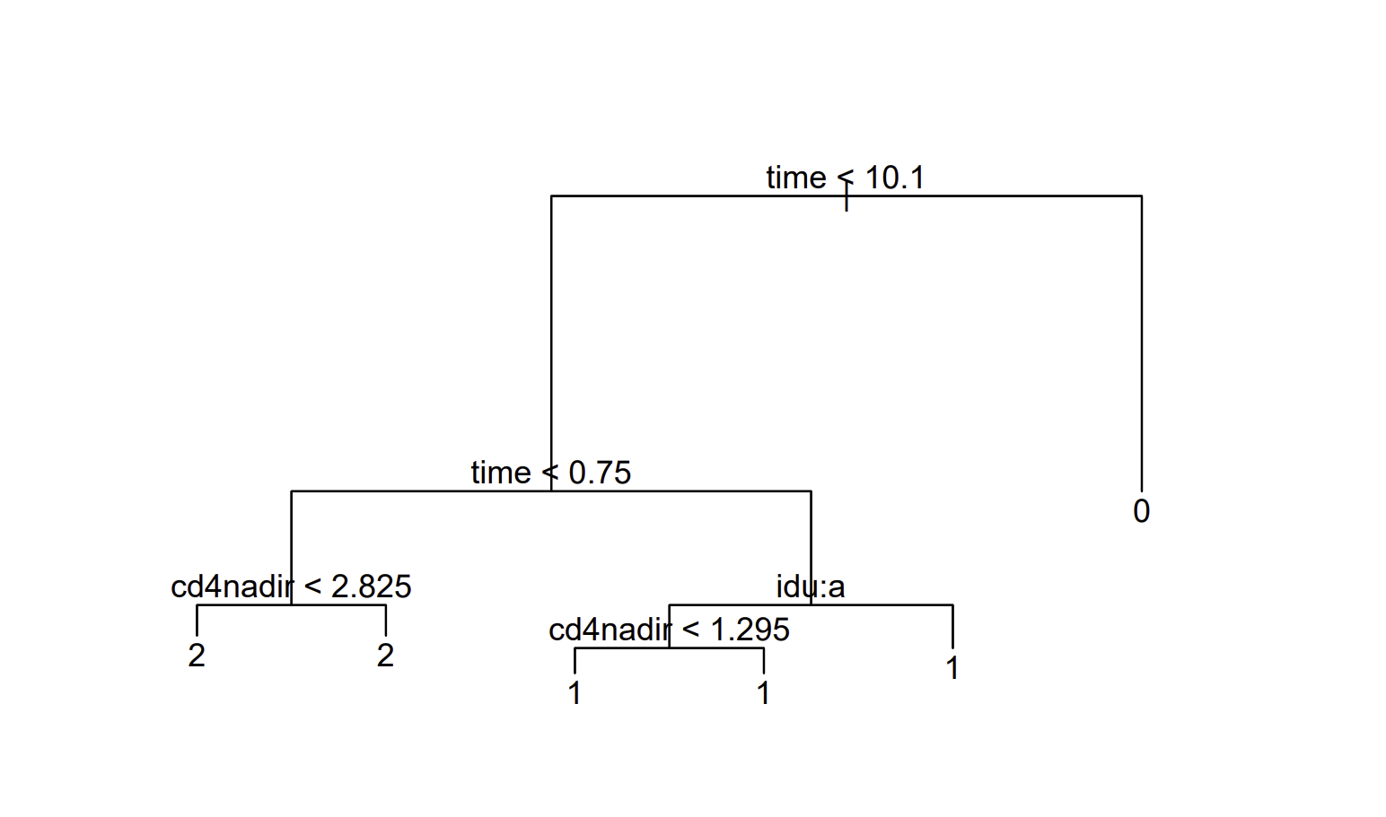
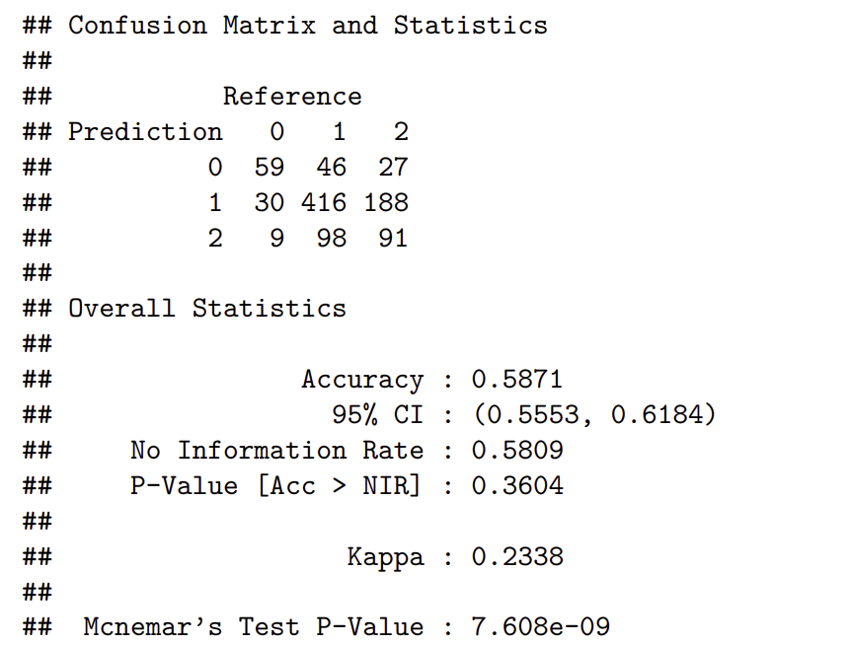
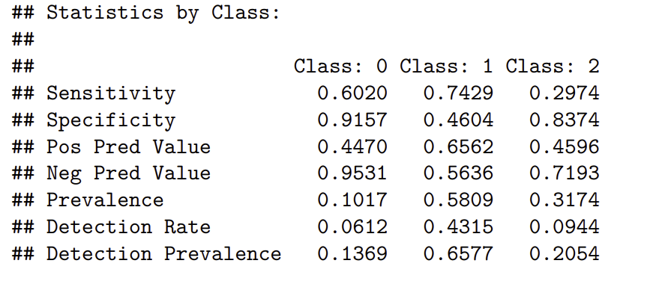
Exploring Predictive Models: Decision Tree
The model's overall accuracy is 58.71%, indicating that approximately 58.71% of the cases were correctly classified.
Sensitivity and Specificity:
For Class 1 (HAART initiation), sensitivity (74.29%), indicating that it effectively identifies true positive cases.
For Class 0 (Censoring), the model demonstrates high specificity (91.57%) but lower sensitivity (60.20%).
For Class 2 (AIDS/Death before HAART), both sensitivity (29.74%) and specificity (83.74%) are moderate.
Notes:
Sen: correctly classify patient with desease with positive result
Spec: correctly classify without disease
Sensitivity and Specificity:
For Class 1 (HAART initiation), the model shows high sensitivity (74.29%), indicating that it effectively identifies true positive cases. However, its specificity (46.04%) is relatively lower, suggesting that it has difficulty correctly identifying true negative cases for this class.
For Class 0 (Censoring), the model demonstrates high specificity (91.57%) but lower sensitivity (60.20%).
For Class 2 (AIDS/Death before HAART), both sensitivity (29.74%) and specificity (83.74%) are moderate.

Slide 31
Exploring Advanced Predictive Models: Random Survival Forests (RSF)
Random Survival Forest is an extension of the Random Forests algorithm, tailored for survival analysis. It uses an ensemble of decision trees to predict the survival function of an individual.
"randomForestSRC" package in R can be used to implement RSF
wihs_obj <- rfsrc(Surv(time, status) ~ ., data = wihs, nsplit = 3, ntree = 100)

Slide 32
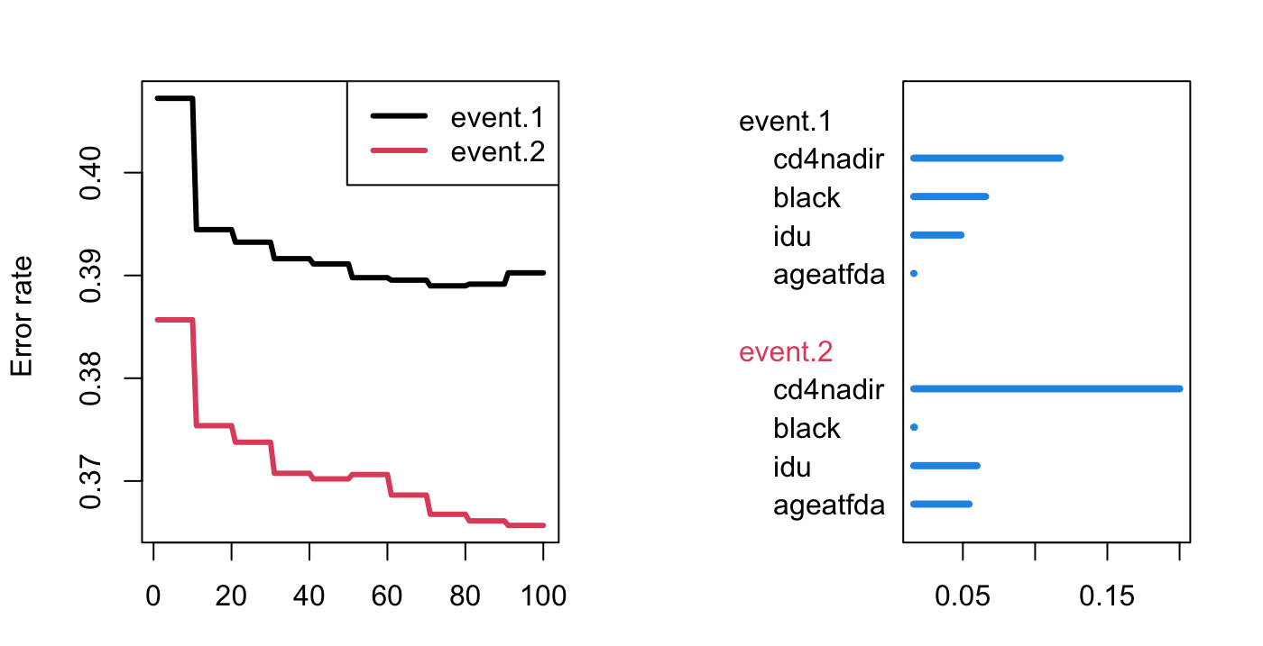

Slide 33

Conclusions
Cox ph model Results: Understanding the Predictors of HIV Progression
CD4 count as a Key Indicator:
Consistent influence across models suggests its central role in managing HIV.
Influence of Age:
Increased hazard with older age points to a need for age-specific treatment strategies.
Variable Impact of IDU and Race:
Non-significant results suggest potential reasons such as sample diversity and socio-economic factors.
Random Survival Forest Results: Important Variables for Predicting HIV Progression
The results highlight the need for personalized treatment plans that consider an
individual’s CD4 count, age, drug use history, and race.
Notes:
slide 17 - More women are at risk as at the time of HAART initiation compared to at the time of being diagnosed with AIDs.
slide 19 - the survival rate for initiation of Highly Active Antiretroviral Therapy (HAART) among the women with HIV decreases with increase in age.
slide 20 -Blacks: African-Americans have a higher probability of survival when the Highly Active Antiretroviral Therapy (HAART) is initiated compared to non-African_American
slide 21 -There is no association between the history of injection drug use at enrollment and the effect of the Highly Active Antiretroviral Therapy (HAART) initiation
slide 23 - the survival rate for the effect of the initiation of Highly Active Antiretroviral Therapy (HAART) among the women with HIV on the diagnosis of AIDs or death decreases with increase in age. Women over 60 years are more vulnerable and least to survive.
slide 24 - Blacks: African-Americans have a higher probability of survival when the Highly Active Antiretroviral Therapy (HAART) is initiated compared to non-African_American. But its effect on the diagnosis or death rate from AIDs is not statistically significant, and there is no difference between blacks who are African_Amereican and the non_African_Amereican.
slide 25 - interesting to note that whiles there was no association between the history of injection drug use at enrollment and the effect of the Highly Active Antiretroviral Therapy (HAART) initiation; there is an association of the HAART effect on the diagnosis or death with IDU history

Slide 34

Implications
Clinical Recommendations:
Emphasize early and aggressive treatment for older women and those with lower CD4 counts.
Regular CD4 monitoring as a staple in HIV treatment protocols.
Public Health Policies:
Advocate for accessible healthcare for all, especially targeting marginalized groups.
Launch educational campaigns on the benefits of early HIV testing and treatment.
Community and Social Support:
Necessity for community programs supporting older adults and IDUs.

Slide 35
Further Studies
Need for longitudinal studies to explore the interactions of social determinants with HIV progression.
Need for More Data: Additional data is essential to draw more definitive conclusions about the impact of HIV treatments on women.
Representative Sample: A more diverse sample is needed to make the findings more generalizable across different subgroups of women.

Slide 36

Thank you!

Slide 37
References
H. Ishwaran, M. Lu, and U. B. Kogalur. 2021. “randomForestSRC: installing randomForestSRC vignette.” http://randomforestsrc.org/articles/installation.html.
Bacon M.C, von Wyl V., Alden C., et al. (2005). "The Women's Interagency HIV Study: an observational cohort brings clinical sciences to the bench," Clin Diagn Lab Immunol, 12(9):1013-1019.
UNAIDS. (2021). Global HIV & AIDS statistics — 2022 Fact sheet. Retrieved from https://www.unaids.org/en/resources/fact-sheet
World Health Organization. (Year). Consolidated guidelines on HIV prevention, diagnosis, treatment, and care for key populations. Retrieved from https://www.who.int/publications/i/item/9789241511124

